Slide 1

Software Engineering
Software Project Management, Architecture & Design
Software Project Management
Department of Computer Science and Engineering
Acknowledgement: Dr. Phalachandra HL, Prof. Anand MS, authors of the prescribed textbooks and materials sourced online.

Slide 2

Software Project Planning
List of Contents
Fundamentals of Software Project Planning
Perspectives of Software Project Planning
Steps in Project Planning
Gantt Charts
Components of a Gantt Chart
Advantages of Gantt Charts
Department of Computer Science and Engineering

Slide 3
Software Project Planning
Planning
First task in project
Outcome: Project plan
Depends on nature of project
Project Manager focuses on what and how
Project plan can evolve over the lifecycle of project
The project manager’s job is to ensure that the software project meets and overcomes these constraints as well as delivering high-quality software

Slide 4
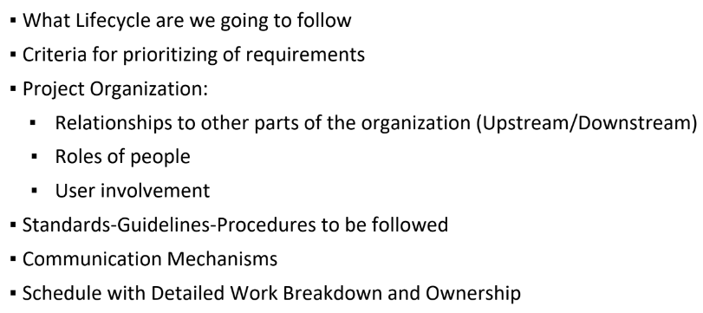
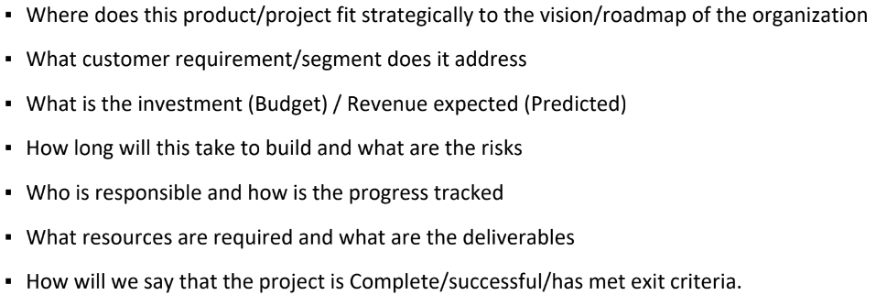
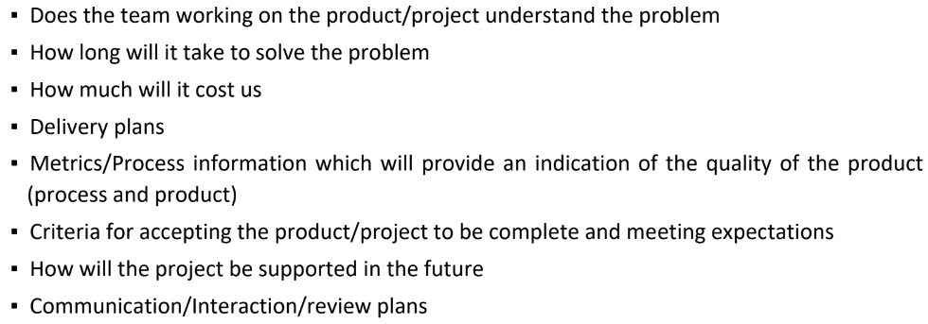
Project Planning perspectives
Sponsor’s perspective
Customer’s perspective
Execution Stakeholder’s perspective
Can you think of the questions to be answered during project planning for each one of these perspectives?
Execution Stakeholder’s perspective
Sponsor’s perspective
Customer’s perspective

Slide 5
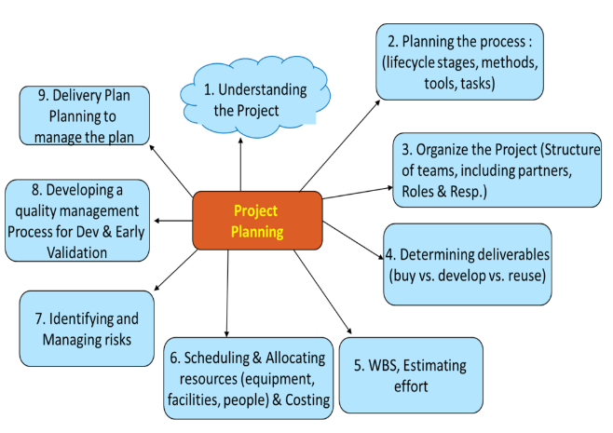
Steps in Project Planning
THE NINE STEPS INVOLVED IN PROJECT PLANNING

Slide 6
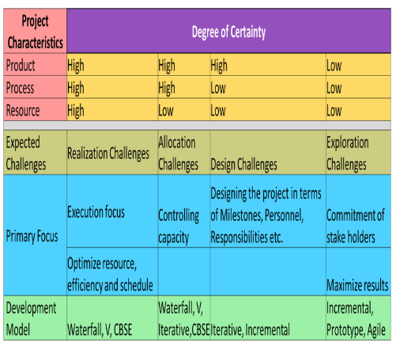
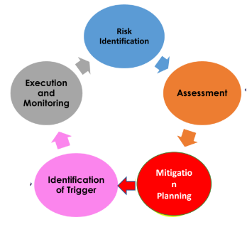
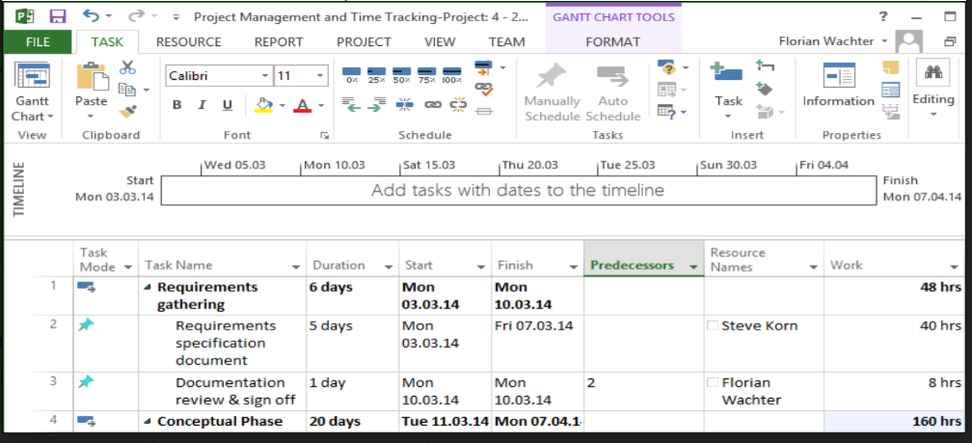
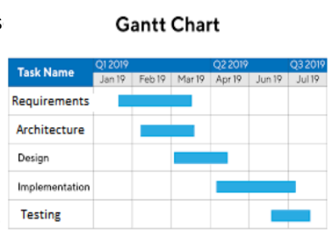

Steps in Project Planning
Scheduling & allocating resources
Identification of risks
Minimize task dependencies
Account for working conditions
Costing
Usage of Microsoft Project for scheduling:
Developing a quality management process
Plan for progress tracking of the project
Communication plans
Quality Assurance plans
Test completion criteria
Early verification or customer validation
Plans for tracking Project Plan & Delivery plan
Plan for management of Project Plan
Procedures for release of product to customer
Staff and people management
Performance management
Compensation and benefits management
Estimation of the Tasks/Activities
Estimation based on
Estimation of the Tasks/Activities
CoCoMo – Cost Constructive Model
Types of CoCoMo
Organize the project
Organizational Structure in terms of people, team &
responsibilities
Identification of eco-system partners for the
Project
Upstream and Downstream partners
Determining deliverables
Buy vs Develop vs Reuse
Work Break Down – Leads to WBS
What is Work Break Down?
Decomposition of the project activities into deliverable
smaller components & is an iterative process
Split project into tasks and activities/ subprojects (Level 1). Break these down further into detailed tasks (Level 2). Now, each task can be meaningfully tracked.
These levels are part of the Work Breakdown Structure (hierarchical structure).
Tasks Phases Work packages for product
Understanding the expected deliverables of the project
Expectations of stakeholders in terms of the
Deliverables
The market forces driving the project
Looking at the high level decisions of Make-Buy-Reuse
Supported by the results of the feasibility study and
the requirements elicited
Risk management
Scheduling & allocating resources
Calendarization of work activities:
Bring concerned individuals to participate in forming the schedule
Identification and allocation of resources according to WBS
Validation of upstream and downstream dependencies for tasks
Organizing tasks concurrently
Usage of tools such as Gantt chart for visualization
Identifying and managing risks
What is ‘Risk’?
Risk is any unexpected event that might affect the people, processes, technology and resources involved
Risk Management can be for Products, Projects, Organizations etc.
Planning the process
Choice of lifecycle based on
- Generics on project characteristics
- Degree of certainty: product, process & resource
Models, standards, guidelines, procedures
Configuration Management, Change management, Quality Plans
Identifying the tools required
Basic
Detailed
Line of code (LoC)
Empirical estimation
Ex: CoCoMo
Intermediate
Experience
Ex: Delphi, Modified Delphi
Function points
(Amount of business functionality in terms
of functions, an information system (as a product) provides to a user)
Organic
Projects based on CoCoMo
Embedded
Semi - detached
Based on KLoC,
Identify milestones for each phase
Entry & exit criteria for each phase
Estimation can be done top down or bottoms up

Slide 7
Outcome & Roles
OUTCOMES OF PROJECT PLANNING
Project plan
Work Break Down
Schedule
Resource Management
Plans for communication, metrics etc.
Risk management plan
ROLES
Project Management
Project Manager

Slide 8
Contents of a Project Plan
▪ Introduction
▪ Deliverables of the project
▪ Process model
▪ Organization of project
▪ Standards, guidelines, procedures
▪ Management activities
▪ Risks
▪ Staffing
▪ Methods and techniques
▪ Quality criteria/assurance
▪ Work packages
▪ Resources
▪ Budget and schedule
▪ Change control process
▪ Delivery means

Slide 9
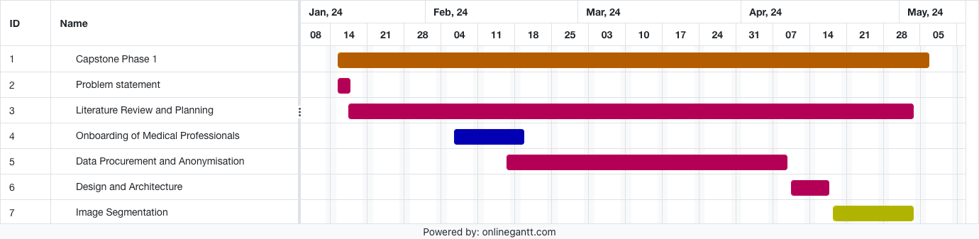
Gantt Charts
Gantt chart is a chart in which series of lines shows the amount of work done or the work to be done in certain periods of time in relation to the amount planned for those periods.
The colors on the bars indicate who is assigned to each task

Slide 10
Components of a Gantt Chart
1. Projects and Tasks: The overall projects and tasks the chart will track, using color to highlight task pairings and dependencies.
2. Timeline: Clearly displays project start and end dates, with a timeline showing where each task stands.
3. Status Bar: Horizontal bars to indicate the progress of each task.
4. Supplemental Info: Includes additional details like task priority, responsibility assignments, and contact information.

Slide 11
Advantages of Gantt Charts
1. A Gantt chart visualizes timelines for one or multiple teams, helping track resource allocation and identify necessary adjustments.
2. It aids in understanding task progress, dependencies, and potential blockages, facilitating better communication and prioritization across teams.
3. A Gantt chart helps monitor delays and guide prioritization decisions.

Slide 12
THANK YOU
Software Project Management
Department of Computer Science and Engineering
‹#›

